Slide 1


Nicolai Lindner
26.08.2024

Slide 2

Outline
Executive Summary
Introduction
Methodology
Results
Conclusion
Appendix

Slide 3
Executive Summary
Summary of methodologies
Data Collection
Data Wrangling
Exploratory Data Analysis with Data Visualization
Exploratory Data Analysis with SQL
Building Interactive map with the use of Folium
Building a Plotly Dash Dashboard
Classification – Predictive Analysis
Summary of all results
Exploratory Data Analysis results
Interactive analytics demo in screenshots
Predictive analysis results

Slide 4
Introduction
Project background and context
Problems you want to find answers

Slide 5

Section 1

Slide 6
Methodology
Executive Summary
Data collection methodology:
Using the SpaceX Rest API
Scraping Wikipedia Data
Perform data wrangling
Filtering data
Missing Values handling
One Hot Encoding for binary classification
Perform exploratory data analysis (EDA) using visualization and SQL
Perform interactive visual analytics using Folium and Plotly Dash
Perform predictive analysis using classification models
Building, tuning and evaluation of classification models to ensure the best results

Slide 7
Data Collection
Data Collection involved API requests with the help of the SpaceX REST API and webscraping the SpaceX Wikipedia entry.
Both of these methods had to be used to get complete information about the launches to perform an analysis.
Data Columns obtained via the SpaceX REST API:
FlightNumber, Date, BoosterVersion, PayloadMass, Orbit, LaunchSite, Outcome, Flights, GridFins, Reused, Legs, LandingPad, Block, ReusedCount, Serial, Longitude, Latitude
Data Columns obtained via webscraping Wikipedia:
Flight No., Launch site, Payload, PayloadMass, Orbit, Customer, Launch outcome, Version Booster, Booster landing, Date, Time

Slide 8
Data Collection – SpaceX API
Requesting rocket launch data from the SpaceX API
Decoding the response content using .json() and turning it into a dataframe using .json_normalize()
Requesting information about launches from SpaceX API by applying custom functions
Constructing data into dictionary
Creating a dataframe from dictionary
Filtering Only Falcon 9 Launches
Replacing missing values of Mass column with the mean values of this column
Exporting data to CSV
https://github.com/NicolaiLindner/pythonexercises/blob/main/Data%20Collection%20API.ipynb

Slide 9
Data Collection - Scraping
Requesting Falcon 9 launch data from Wikipedia
Creating BeautifulSoup object from HTML response
Extracting column names from the table Header
Collecting data by parsing tables
Filling data into dictionary
Creating a dataframe from the dictionary
Creating a dataframe from the dictionary
Exporting data to CSV
https://github.com/NicolaiLindner/pythonexercises/blob/main/Data%20Collection%20with%20Web%20Scraping.ipynb

Slide 10
Data Wrangling
The dataset contains various scenarios where a rocket booster either successfully or unsuccessfully landed. The outcomes are categorized as follows:
True Ocean: The booster successfully landed in a specific ocean region.
False Ocean: The booster attempted but failed to land in the ocean.
True RTLS (Return to Launch Site): The booster successfully landed on a ground pad.
False RTLS: The booster failed to land on a ground pad.
True ASDS (Autonomous Spaceport Drone Ship): The booster successfully landed on a drone ship.
False ASDS: The booster attempted but failed to land on a drone ship.
These outcomes are converted into training labels: "1" for successful landings and "0" for unsuccessful ones.
Perform EDA and tetermine training labels
Calculate the number of launches per site
Calculate the number and frequency of each orbit type
Calculate the number and frequency of mission outcomes per orbit type
Create a landing outcome label from the outcome column
Export the data to CSV
https://github.com/NicolaiLindner/pythonexercises/blob/main/Data%20Wrangling.ipynb

Slide 11
EDA with Data Visualization
Charts Plotted:
Various relationships were analyzed, including flight number versus payload mass, flight number versus launch site, payload mass versus launch site, orbit type versus success rate, flight number versus orbit type, payload mass versus orbit type, and yearly trends in success rates.
Chart Types and Their Purpose:
Scatter Plots: Used to explore the relationships between different variables. These plots help determine if there’s a correlation that could be leveraged in a machine learning model.
Bar Charts: Focus on comparing different categories, illustrating the relationships between specific groups and a measured outcome.
Line Charts: Employed to observe trends over time, particularly in time series data, helping to visualize how success rates or other variables evolve.
https://github.com/NicolaiLindner/pythonexercises/blob/main/EDA%20with%20Data%20Visualization(1).ipynb

Slide 12
EDA with SQL
Performed SQL Queries:
Displayed the unique launch site names involved in space missions.
Retrieved five records where launch sites start with the string "CCA."
Calculated the total payload mass carried by boosters launched by NASA (CRS).
Computed the average payload mass carried by the booster version F9 v1.1.
Identified the date of the first successful ground pad landing.
Listed the boosters that successfully landed on a drone ship and carried a payload mass between 4000 and 6000.
Tallied the total number of successful and failed mission outcomes.
Listed the booster versions that carried the maximum payload mass.
Identified failed landing outcomes on drone ships, along with their booster versions and launch site names, specifically for the months in the year 2015.
Ranked landing outcomes (such as failures on drone ships and successes on ground pads) between June 4, 2010, and March 20, 2017, in descending order.
https://github.com/NicolaiLindner/pythonexercises/blob/main/EDA%20with%20SQL.ipynb

Slide 13
Build an Interactive Map with Folium
Markers of All Launch Sites:
Added a marker with a circle, popup label, and text label at NASA Johnson Space Center, using its latitude and longitude as the starting point.
Placed markers with circles, popup labels, and text labels for all launch sites, showing their geographical locations and proximity to the Equator and coastlines.
Colored Markers for Launch Outcomes at Each Site:
Included colored markers to indicate the success (green) and failure (red) of launches, using marker clusters to highlight which launch sites have higher success rates.
Distances Between Launch Sites and Proximities:
Added colored lines to depict distances between launch sites (e.g., KSC LC-39A) and nearby features like railways, highways, coastlines, and the nearest city.
https://github.com/NicolaiLindner/pythonexercises/blob/main/Interactive%20Visual%20Analytics%20with%20Folium%20lab.ipynb

Slide 14
Build a Dashboard with Plotly Dash
Launch Sites Dropdown List:
Added a dropdown list to allow users to select a specific launch site.
Pie Chart Showing Success Launches (All Sites/Certain Site):
Included a pie chart to display the total number of successful launches across all sites. When a specific launch site is selected, the chart shows a comparison of success versus failure counts for that site.
Slider for Payload Mass Range:
Added a slider control to enable users to select a specific range of payload mass.
Scatter Chart of Payload Mass vs. Success Rate for Different Booster Versions:
Introduced a scatter chart to visualize the correlation between payload mass and launch success rates, differentiated by booster versions.
https://github.com/NicolaiLindner/pythonexercises/blob/main/spacex_dash_app.py

Slide 15
Predictive Analysis (Classification)
Creating a NumPy Array:
Start by converting the "Class" column in the dataset into a NumPy array.
Standardizing the Data:
Use StandardScaler to standardize the data, then fit and transform it to prepare for modeling.
Splitting the Data:
Split the data into training and testing sets using the train_test_split function.
Setting Up GridSearchCV:
Create a GridSearchCV object with cv = 10 to identify the best model parameters.
Applying Models:
Apply GridSearchCV to different models, including Logistic Regression, SVM, Decision Tree, and KNN.
Calculating Accuracy:
Evaluate the models accuracy on the test data using the „.score()“ method for each model.
Confusion Matrix:
Generate and examine the confusion matrix for all models to assess performance
Comparing Metrics:
Identify the best-performing method by analyzing the „Jaccad_score“ and „F1-Score“ metrics.
https://github.com/NicolaiLindner/pythonexercises/blob/main/Machine%20Learning%20Prediction(1).ipynb

Slide 16
Results
Exploratory data analysis results
Interactive analytics demo in screenshots
Predictive analysis results

Slide 17

Section 2

Slide 18
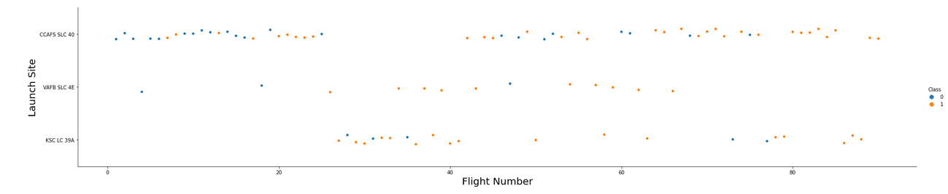
Flight Number vs. Launch Site
Observations from the Scatter Plot:
Early Flights and Success Rates:
The plot shows that the earliest flights across all launch sites predominantly resulted in failure (marked by blue dots). As the flight numbers increase, indicating later missions, the success rate improves significantly (marked by orange dots). This trend suggests that experience and iterative improvements contributed to higher success rates over time.
Launch Site Distribution:
The CCAFS SLC 40 site accounts for about half of the total launches, indicating it is a major hub for these missions. Despite the high number of launches, the success rate at this site is mixed, especially in the earlier missions.
Higher Success Rates at Specific Sites:
The VAFB SLC 4E and KSC LC 39A launch sites display higher success rates compared to CCAFS SLC 40. The scatter plot shows a higher concentration of orange dots (successful missions) at these sites, suggesting that these locations might have better infrastructure or conditions that contribute to successful launches.
Improvement Over Time:
The data implies that with each new launch, particularly at VAFB SLC 4E and KSC LC 39A, the likelihood of success has increased. This could be due to technological advancements, better launch procedures, or more optimized site conditions over time.

Slide 19
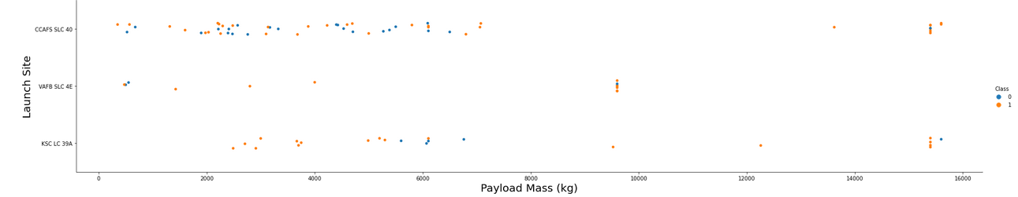
Payload vs. Launch Site
Observations from the Scatter Plot:
Payload Mass and Success Rate:
Across all launch sites, there is a noticeable trend where higher payload masses are associated with a higher success rate. This is evident from the increased number of orange dots (indicating successful launches) as payload mass increases.
Success Rates for High Payload Masses:
Most launches carrying payloads over 7000 kg were successful, regardless of the launch site. This suggests that the systems are well-engineered to handle larger payloads effectively, possibly because of more rigorous checks and optimizations for high-stakes missions.
KSC LC 39A Performance:
The KSC LC 39A site shows a particularly strong performance with a 100% success rate for payloads under 5500 kg. This indicates that launches from this site are highly reliable, especially for lower to mid-range payload masses.

Slide 20
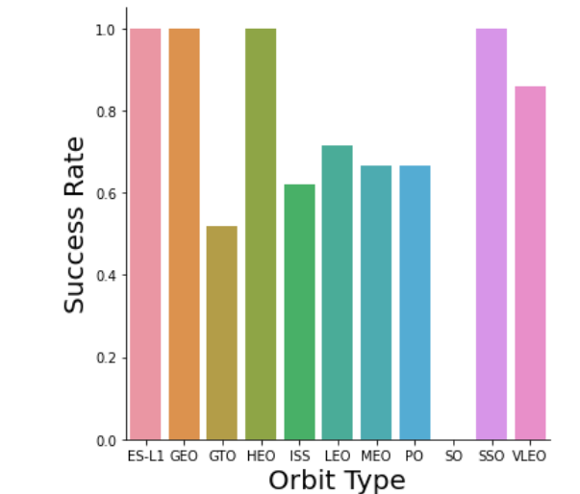
Success Rate vs. Orbit Type
Success Rate by Orbit Type:
Orbits with a 100% Success Rate:
ES-L1, GEO, HEO, SSO: These orbit types have achieved a perfect success rate in all recorded launches. This indicates a strong reliability in missions targeting these orbits, possibly due to optimized launch procedures, favorable conditions, or extensive experience with these types of missions.
Orbit with a 0% Success Rate:
SO (Solar Orbit): Unfortunately, this orbit type has seen no successful launches in the dataset. This could point to the challenges and complexities involved in reaching or maintaining a solar orbit, requiring further investigation and improvement.
Orbits with a Success Rate Between 50% and 85%:
GTO, ISS, LEO, MEO, PO: These orbits have varying success rates, indicating moderate reliability. The success rates suggest that while missions to these orbits are generally feasible, they still pose significant challenges, which may include technical difficulties, environmental factors, or the inherent risks associated with these specific orbital paths.

Slide 21
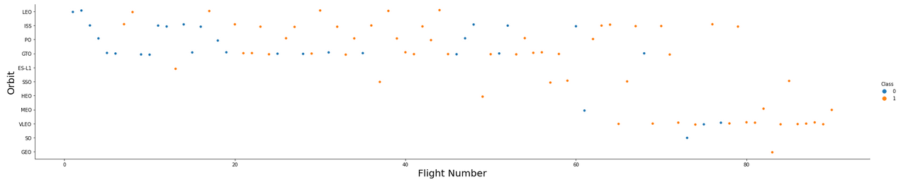
Flight Number vs. Orbit Type
Relationship Between Flight Number and Success Rate in Different Orbits:
LEO Orbit (Low Earth Orbit):
In the LEO orbit, there is a clear trend where success (indicated by orange dots) appears to increase with the number of flights. This suggests that the more missions conducted in LEO, the higher the likelihood of success, likely due to accumulated experience and refined techniques over time. The pattern shows that earlier flights had a mix of successes and failures, but as the flight numbers increased, the success rate improved significantly.
GTO Orbit (Geostationary Transfer Orbit):
In contrast, for the GTO orbit, there doesn’t seem to be a strong relationship between the flight number and success rate. The successes and failures are more evenly distributed across different flight numbers, indicating that factors other than just experience (such as inherent technical challenges or specific mission conditions) might be influencing the success rate in this orbit.

Slide 22
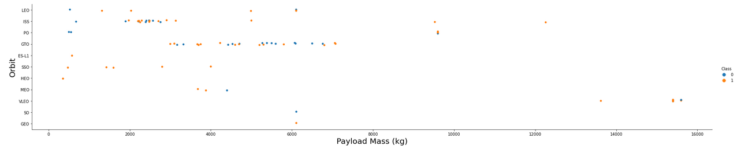
Payload vs. Orbit Type
Observations:
GTO Orbit:
Negative Influence of Heavy Payloads: For the GTO orbit, there’s a noticeable trend where heavier payloads tend to result in more failures (blue dots). This suggests that as the payload mass increases, the success rate decreases, indicating that heavy payloads negatively impact mission success in the GTO orbit.
LEO (Including ISS) and Polar Orbits:
Positive Influence of Heavy Payloads: In contrast, for LEO (including ISS) and Polar orbits, heavier payloads seem to have a positive influence. The graph shows a higher concentration of successful missions (orange dots) with heavier payloads, indicating that these orbits are more capable of handling larger masses effectively.

Slide 23
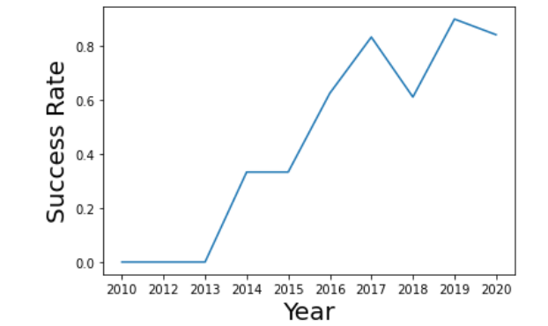
Launch Success Yearly Trend
The success rate since 2013 keeps on increasing!

Slide 24
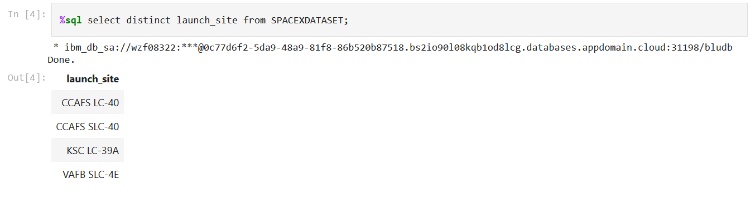
All Launch Site Names
Displaying unique (distinct) launch sites from the space mission dataset.

Slide 25
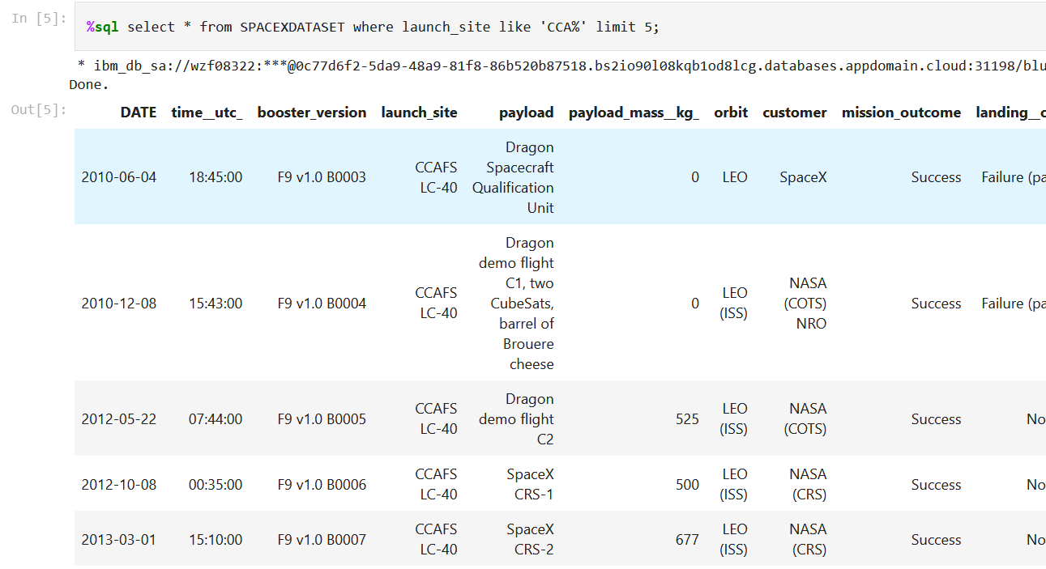
Launch Site Names Begin with 'CCA'
Here are 5 records where the launch sites begin with the string “CCA”:

Slide 26
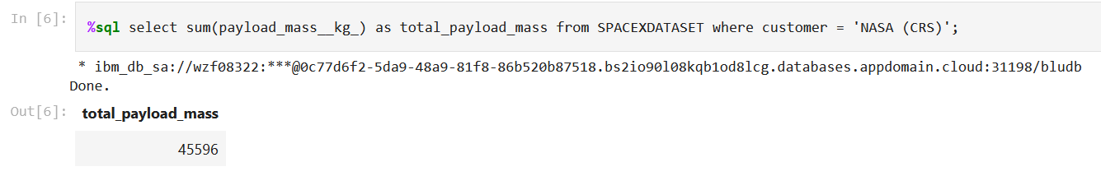
Total Payload Mass
To see here is the total payload mass carried by boosters launched by NASA (CRS)

Slide 27
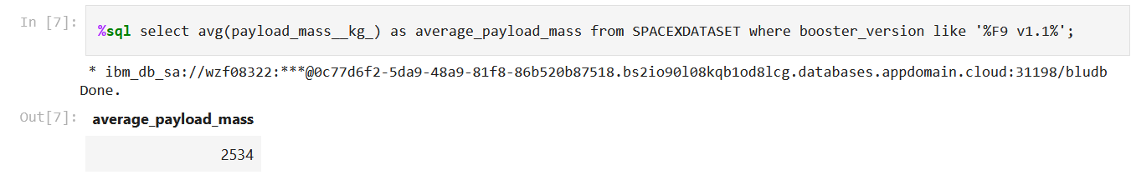
Average Payload Mass by F9 v1.1
Being displayed here is the average payload mass carried by booster version F9 v.1.1.

Slide 28
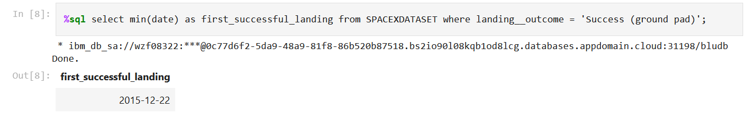
First Successful Ground Landing Date
To see here is the first date a successful landing outcome in ground pad was seen

Slide 29
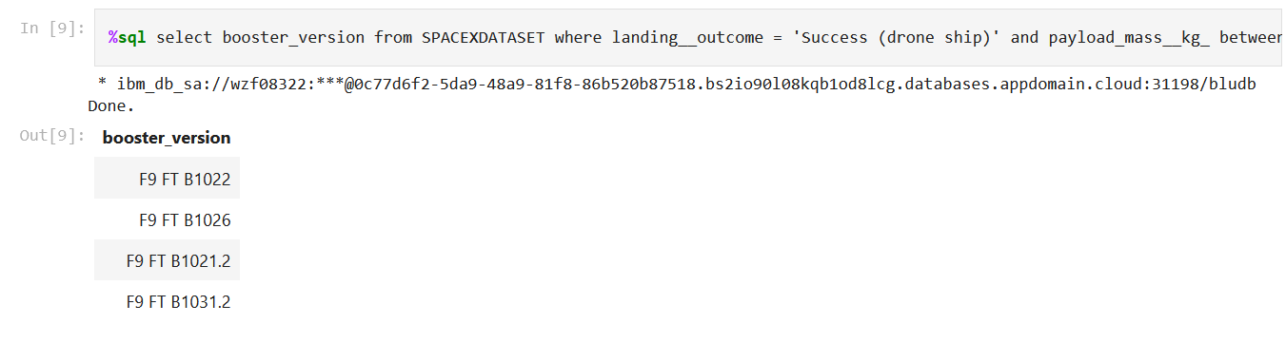
Successful Drone Ship Landing with Payload between 4000 and 6000
To see here are the booster names which had success in drone shup and have a payload mass > 4.000 but <= 6.000.

Slide 30
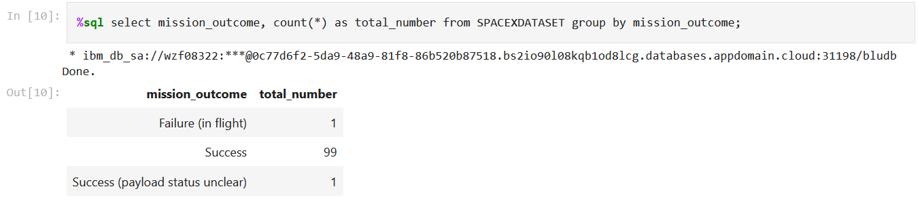
Total Number of Successful and Failure Mission Outcomes
To see here are the total number of successful and failure mission outcomes.

Slide 31
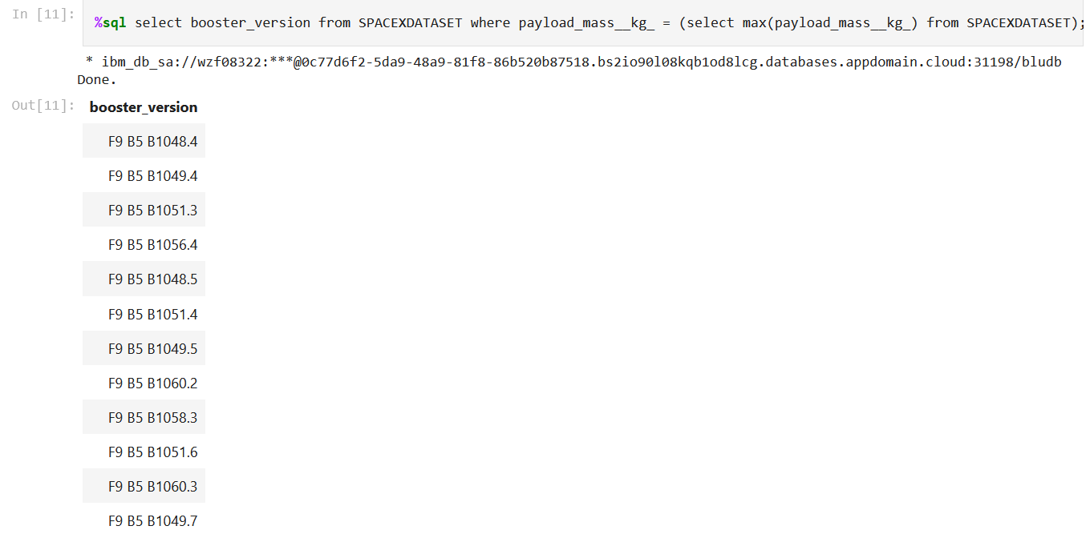
Boosters Carried Maximum Payload
To see here are the booster version names which carried the max. payload mass.

Slide 32
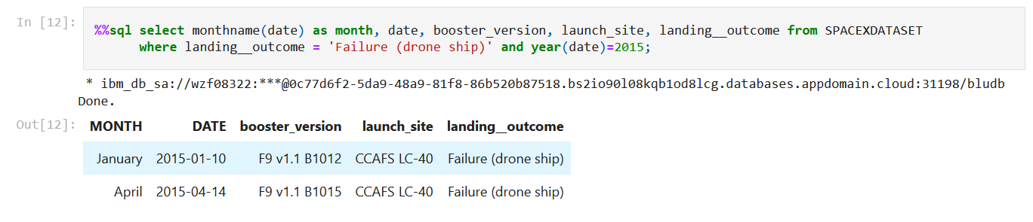
2015 Launch Records
Listing the failed landing outcomes in drone ship, their booster versions and launch site names for all months in the year of 2015.

Slide 33
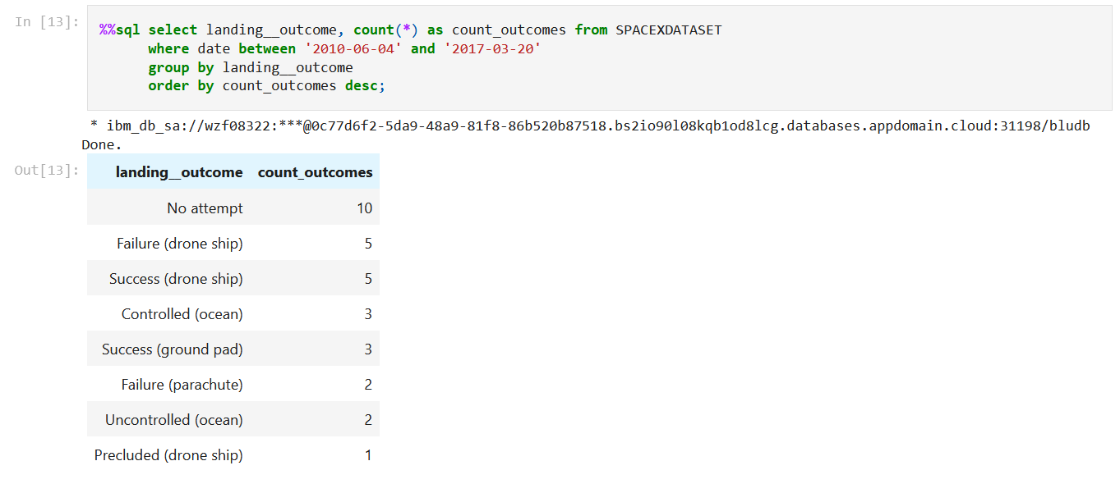
Rank Landing Outcomes Between 2010-06-04 and 2017-03-20
To see here are the ranking of the counts of landing outcomes between the date of 2010-06-04 and 2017-03-20 in descending order.

Slide 34

Section 3

Slide 35
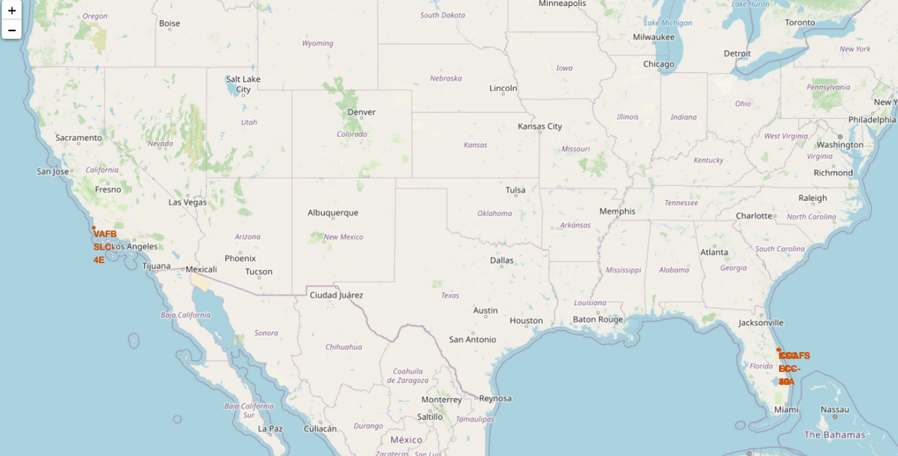
All launch sites’ location markers on a global map
Launch Site Locations on the Global Map:
Proximity to the Equator:
Most of the launch sites are strategically located near the equator. The Earth’s surface at the equator is moving the fastest due to its rotation (about 1670 km/hour). Launching rockets from these locations gives them an additional speed boost, making it easier for them to reach orbit.
Coastal Locations:
All the launch sites are situated close to the coastlines. This is intentional; launching rockets over the ocean minimizes the risk to human populations. If anything goes wrong during launch, debris or an explosion is more likely to fall into the ocean, away from populated areas.

Slide 36
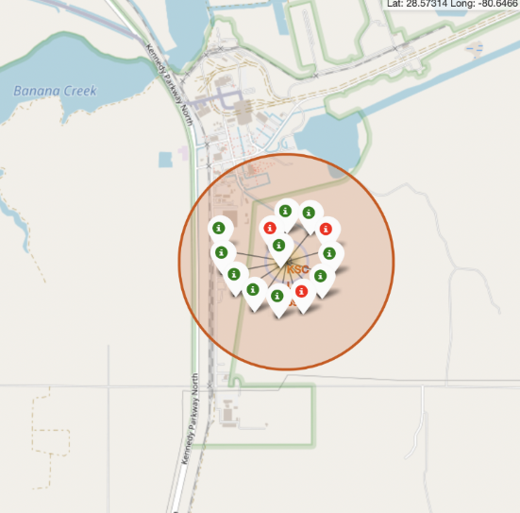
Color labeled launch records
The color identifies which launch sites had high success rates.
Green Markers = Successful Launch
Red Markers = Failed Launch
Launch Site KSC LC-39 A had a good score.

Slide 37
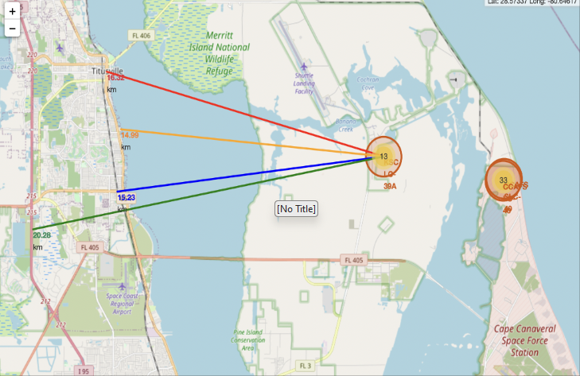
Proximity to the launch site KSC LC-39A
Explanation:
Close to railway (15.2 km)
Close to highway (20.3 km)
Close to coastline (15 km)
Also launch site is close to city Titusville (16.3 km)
Failed rockeds could be dangerous for city are!

Slide 38

Section 4

Slide 39
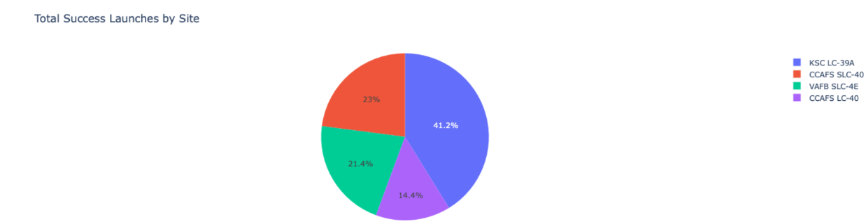
Success Rate by Launch Site
Explanation:
The pie chart highlights that KSC LC-39A accounts for the highest percentage of successful launches among all sites, representing 41.2% of the total.

Slide 40
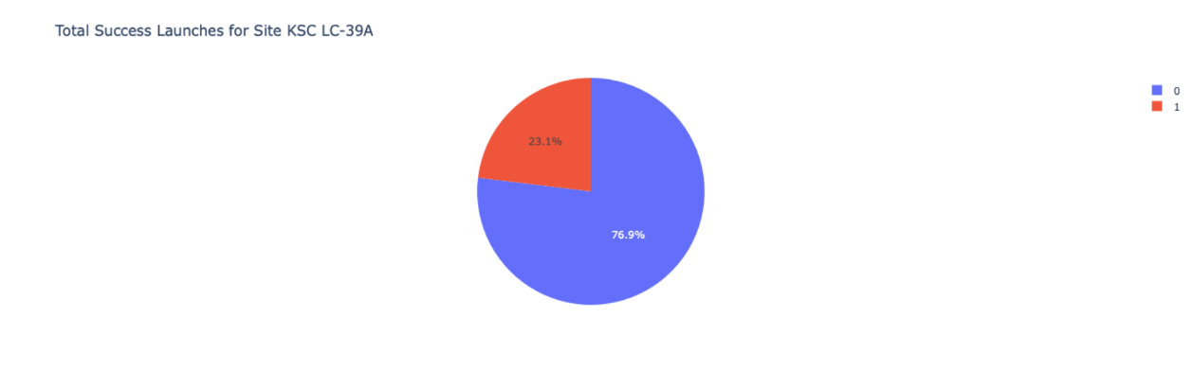
Highest Success Ratio by Launch Sites
Explanation:
KSC LC-39A boasts the highest launch success rate at 76.9%, with 10 successful launches and only 3 failures.

Slide 41
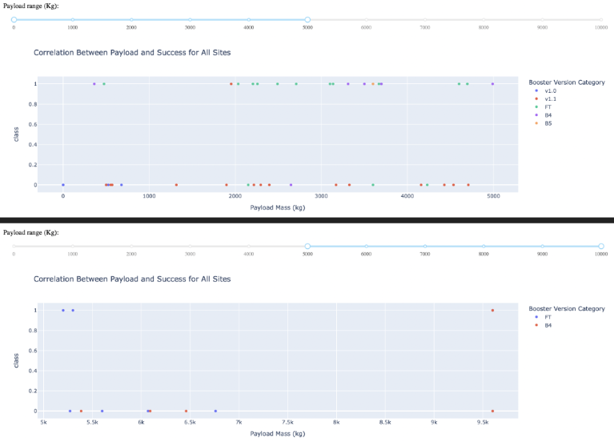
Correlation Between Payload Mass and Launch Success
Explanation:
The charts indicate that payloads within the 2000 to 5500 kg range achieve the highest success rates across all launch sites, suggesting an optimal payload range for reliable mission outcomes.

Slide 42

Section 5

Slide 43
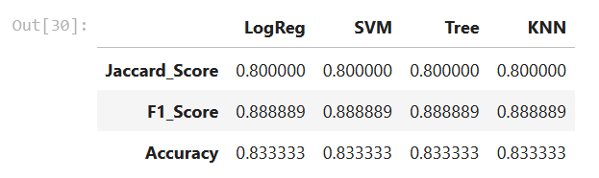
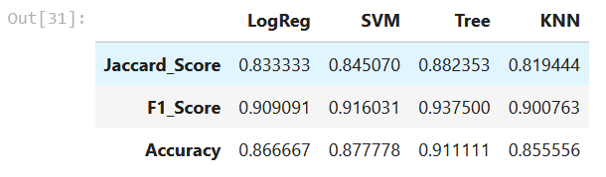
Classification Accuracy
Scores and Accuracy on Test Set
Scores and Accuracy on Entire Dataset
Explanation:
Test Set Results:
The initial evaluation based on the Test Set scores (18 samples) does not conclusively determine which model performs the best. All four models (Logistic Regression, SVM, Decision Tree, and KNN) produced identical accuracy, Jaccard, and F1 scores. This uniformity in scores might be due to the small size of the test set, limiting the ability to differentiate model performance.
Whole Dataset Evaluation:
To get a more reliable assessment, the models were evaluated using the entire dataset. The Decision Tree model outperformed the others, achieving the highest scores across all metrics: Jaccard Score, F1 Score, and Accuracy. This suggests that the Decision Tree model is the most robust for this classification task when considering the full range of available data.
Conclusion:
While the Test Set results were inconclusive due to sample size limitations, the evaluation on the entire dataset confirmed that the Decision Tree model is the most effective, providing the highest accuracy and reliability for predictions.

Slide 44
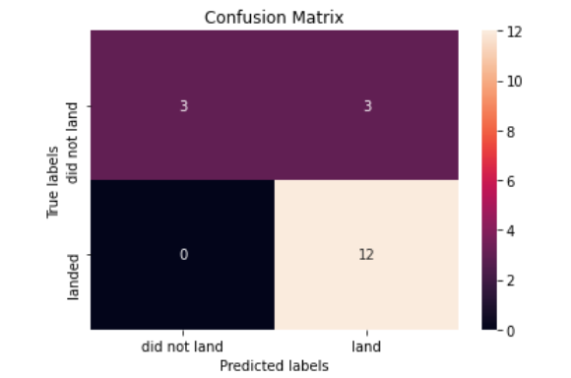
Confusion Matrix
Explanation:
Major Problem are false positives, but the logistic regression method is doing quite well distinguishing between the different classes.

Slide 45
Conclusions
The Decision Tree Model outperforms others for this dataset, offering the best accuracy and reliability.
Lower payload masses result in higher success rates compared to heavier payloads.
Launch sites are strategically located near the Equator and coastlines to maximize efficiency and safety.
The success rate of launches improves over time, reflecting advancements and accumulated experience.
KSC LC-39A stands out with the highest success rate among all launch sites.
Orbits like ES-L1, GEO, HEO, and SSO have achieved a perfect 100% success rate.

Slide 46


